Slide 1
Team Problem Solving Workshop
Copied from Ben Root’s presentation to the Order Evolution team leads in 2014.
Slide notes by Dan Rogers
Notes:
This class was presented to the OE Leads over the course of two days.
Workshop 1 occurred in the morning. Then we went to the stores that afternoon to investigate problems.
Workshop 2 occurred the next morning. Then we returned to the stores to implement countermeasures.
Workshop 3 was an hour long report-out with Jeff Abate and Jon Hock.
The instructors said this was very rushed. They typically spend one weekend on workshop 1, then give teams a few weeks to investigate their problem more deeply. Then they spend a weekend on workshop 2 and get a few more weeks to implement countermeasures. When done this way they may actually have sustained results by the time they meet again for workshop 3 and the report-out/celebration.

Slide 2
Welcome
Why Problem Solving?

Slide 3
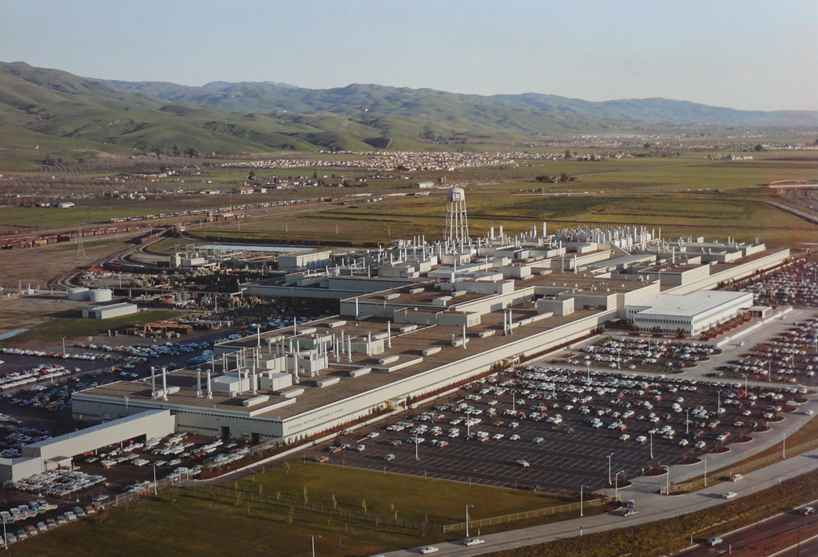
New United Motor Manufacturing Inc.
Notes:
There’s an excellent NPR article about the shutdown of the GM Fremont plant and the re-opening of it by Toyota.
Ben Root had tears in his eyes when he talked about all the workers who came to work one morning only to find the plant’s doors were locked and they had no jobs.
“Lean is something you do for people. Not something you do to them.”

Slide 4
Introductions
Name
Position
Experience with Lean
What would you like to get out of this training?

Slide 5
Course Schedule
Day 1 | Day 2 | Day 3
Workshop One Review value added work Review 7 Wastes Learn Steps 1-3 Define the problem Identify cause of problem Investigate causes Display results of your investigation | Workshop Two Present Steps 1-3 Learn Steps 4-6 Brainstorm possible countermeasures Select countermeasures Make plan to implement countermeasures | Workshop Three Prepare to Present Present Steps 1-6 Celebration
Check In Team check in with coach | Check In Team check in with coach

Slide 6
Value Added Work
When buying a car for you 15 years ago?
When buying a car for your son today?
For your daughter?
Mother?
Notes:
Customers are all different
Don’t lump them together
What do they need?
Our customer might be store management

Slide 7
Three Types of Work

Slide 8
Value Added Work
Value added work is what the customer is willing to pay for.
Can you think of examples of Value added work in the stores?

Slide 9
Necessary Work (but not Value Added)
Going to the store to buy paint
Traveling to work
Cleaning

Slide 10
Waste
Muda
Something that does not add value
Doing something that the customer is not willing to pay for.

Slide 11
Seven Wastes
Motion/Walking
Waiting
Conveyance
Inventory
Defects/Reworks
Overproduction
Over Processing
Notes:
These are simple so that they can be communicated to anyone.
Associates just “get it” when you talk about walking, waiting, etc.

Slide 12
What Causes Waste?
Unevenness
Overburden
Notes:
Unevenness
Price discounts / promotions causes this
Holidays/seasonality
Overburden
Trucks too big
Arrives at wrong time

Slide 13

Unevenness
Notes:
Cars:
Old method:
Switch from 2015 to 2016 model
Ease off production
Lay off workers for 3 months to re-tool plant
New method:
Now they have seamless switch-over
The first 2016 model rolls down the line right behind the last 2015
Same line. Same workers. New parts already in place.

Slide 14
Overburden
Employees overworked
The process is stressed

Slide 15
A Competitor is Building the Same Business Across the Street
One Part
One Machine
One Employee
One Hour

Slide 16
What happens when the water level drops?
?
Notes:
Extra resources protect you from the pain of these inefficiencies (but they also cost you extra)
Inventory, extra people/hours, extra space
When these start getting tighter problems start to emerge

Slide 17
How many of you can run a business?
How may of you can fix a business?
Shingeo Shingo
Lean gives you the tools, method and culture to fix a business

Slide 18
PROBLEM SOLVING
Upper Management
Supervisor
Team Leader
Team Member
Notes:
Whose job is it to solve problems?
A: Everyone

Slide 19
Six Step Problem Solving
Define the Problem
Identify the cause of the problem
Investigate the causes
Brainstorm possible countermeasures
Select and implement countermeasures
Sustain the good result

Slide 20
Are Problems:
Bad?
Good?
Notes:
At Toyota problems are welcomed “like a gold nugget”.
If I know what the problem is I can work on fixing it.
Toyota president came from Japan in response to a big electrical problem
Employees feared plant shutdown
President: “no one here is smiling. We now have a problem we can work on fixing.”

Slide 21
Who Should Solve Problems?
Notes:
Answer: everybody

Slide 22
Define the word “Problem”
Notes:
A: Deviation from a standard or expectation
When you define a problem you must also be identify the standard from which it deviates.
WARNING: Do not say the problem is “lack of a standard.” If you don’t have a standard, how can you have a problem?

Slide 23
Types of Problems
People
Technical
Process
Quality
Notes:
People – not individuals. Rather, people as a whole
Technical – machine / computer / tool
If you have a process that is a sequence of steps, the problem is usually in the transition between each step. Not with the individual steps or the people doing those steps.

Slide 24
Brainstorming

Slide 25
Brainstorm Exercise
Review Rules of Brainstorming
Uses of a paperclip
Notes:
Get everyone comfortable enough to contribute
Paperclip: Dave had 11 ideas
Together we had 20+
Teach team that the group is bigger than the individual

Slide 26
Brainstorming
Each team will list on a flip chart the problems they have encountered in their work area.

Slide 27
Narrow the Problems to No More than Four
Circle = May be easy to fix this problem
Triangle = Caution may be required
X = It may be very difficult or impossible

Slide 28
Select the Problem Using the Filter Sheet
Problem | Importance | Resources | Buy-In | Urgency | Scope of Control
1.
2.
3.
4.

Slide 29
Narrow Down to One
Be sure you are working on only one problem

Slide 30
Step 1: Define the Problem
Write a Problem Statement

Slide 31
The Problem Statement
Has a standard
Is clear
Is measurable
Has a defined time period
Notes:
What? Where? When? Who?
How often? How Many?

Slide 32
The Problem Statement Should be Clear

Slide 33
The Problem Statement
4 W’s
What
Where
When
Who
2 H’s
How Often?
How Many?

Slide 34


Draw the Problem

Slide 35
Background / History
How long has this been a problem?
Has anyone tried to solve it before?
Why is it important to solve now?

Slide 36
Write the Background or History of the Problem

Slide 37

Goal
Mirror image of the problem
Realistic
Achievable
Target vs. Goal

Slide 38
Write a Goal Statement

Slide 39
Step 2 – Identify the Cause of the Problem

Slide 40
The Cause
Fishbone Diagram
Cause and Effect diagram
Ishikawa Diagram
Example: Bad tasting coffee

Slide 41
Fishbone Diagram – Bad Tasting Coffee
Man
Method
Bad Tasting Coffee
Machine
Material

Slide 42
Select Two Possible main Causes
Narrow down the list of causes to two main causes
Everyone gets three votes

Slide 43
Step 3 – Investigate the Cause of the Problem

Slide 44
INVESTIGATION METHODS
Hands on
Observation
Interview
Survey
Past records or data

Slide 45
Exercise: Plan for Investigating Cause of Bad Tasting Coffee
INVESTIGATION | WHAT | WHEN | WHERE | WHO
OBSERVE
HANDS ON
INTERVIEW
SURVEY
RECORDS

Slide 46
Fishbone Diagram – Bad Tasting Coffee
Man
Method
Bad Tasting Coffee
Machine
Material

Slide 47
Plan for Investigating Causes of the Problem
INVESTIGATION | WHAT | WHEN | WHERE | WHO
OBSERVE
HANDS ON
INTERVIEW
SURVEY
RECORDS

Slide 48
What did you find during the investigation?

Slide 51
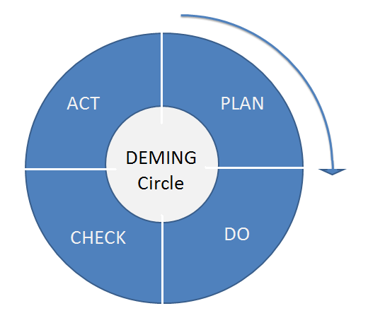
P-D-C-A

Slide 52
Prepare to Present Steps 1-3
Team Presentation
How to get your points across
What is the “story”?
Speak with facts
Everyone participate
15 minutes to present
10 minutes Q&A

Slide 53
Team Problem Solving – Workshop Two

Slide 54
Present Steps 1-3
Team Presentation
How to get your points across
What is the “story”?
Speak with facts
Everyone participate
15 minutes to present
10 minutes Q&A

Slide 55
Step 4 – Brainstorm Possible Countermeasures

Slide 56
Possible Countermeasures
Brainstorm a list of countermeasures
Narrow the list down to no more than four

Slide 57
Step 5 – Select and Implement Countermeasures

Slide 58
Use the Filter Sheet to Select Two Countermeasures
Counter-measures | Importance | Resources | Buy-In | Urgency | Scope of Control
1.
2.
3.
4.
O = Yes, Triangle = Maybe, X = No

Slide 59
Create a Plan
Create a plan to implement the countermeasures
What will you do?
When?
Who will do it?

Slide 60
Plan for Countermeasures
What needs to be done? | When will you do it? | Where will it be done? | Who will do it?

Slide 61
Measure the Results
Was there a cost improvement?
A quality improvement?
Did you improve safety?
Did productivity improve?
Was there elimination of Waste?
Were there cost savings?

Slide 62
Display the Results of Your Investigation
Describe in your own words or illustrate with charts and graphs what you found during the investigation.
Speak with facts.

Slide 63
Step 6 – Sustain the Good Results

Slide 64
Sustain or Maintain the Good Results
How will you keep the cause of the problem from reoccurring?
Is there a plan to manage the system?
Who will do the checking and what will they check?
How often?

Slide 65
P-D-C-A

Slide 66
Present
Team Presentation
How to get your points across
What is the “story”?
Speak with facts
Everyone participate
15 minutes to present
10 minutes Q&A

Slide 67
Prepare Presentation Steps 1-6
Although you will be presenting all six steps of the Problem Solving, the focus of this presentation is on steps 4-6.

Slide 68
Problem Solving Workshop Three

Slide 69
Prepare Presentation Steps 1-6
Although you will be presenting all six steps of the Problem Solving, the focus of this presentation is on steps 4-6.

Slide 70
Present
Team Presentation
Everyone participate
15 minutes to present
10 minutes Q&A

Slide 71

CELEBRATE!!

